Slide 1
Weekly Report
10/24/22
Erin Ingram & Omar Mahmood
NanoBio Systems Lab
Texas A&M University

Slide 2
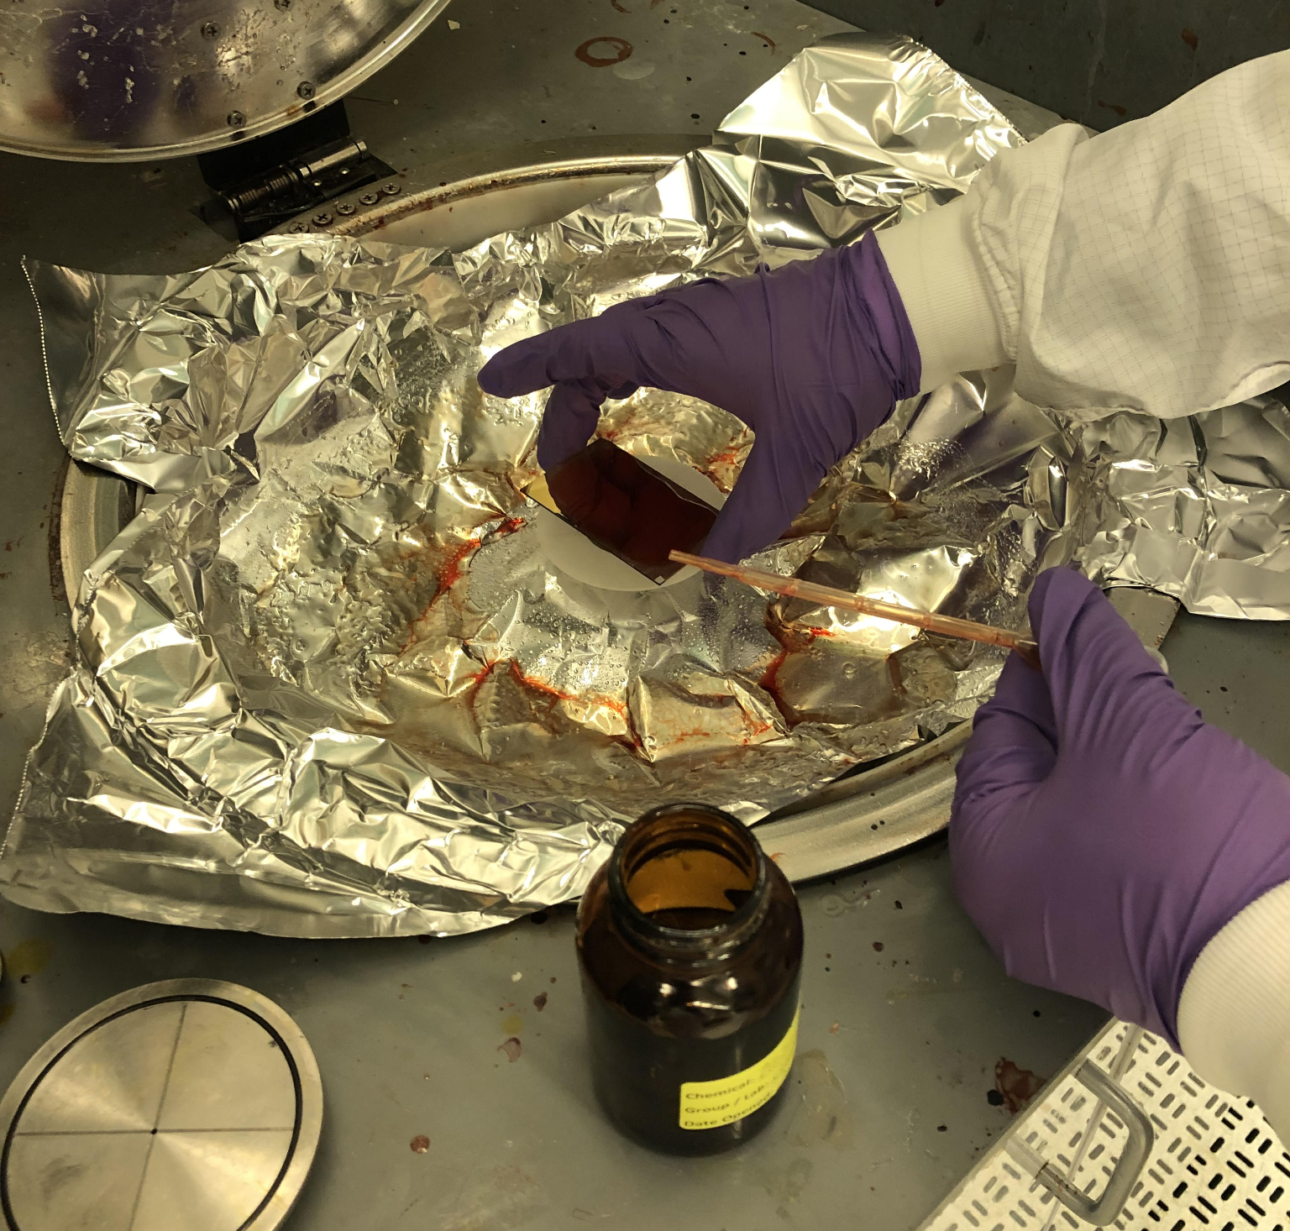
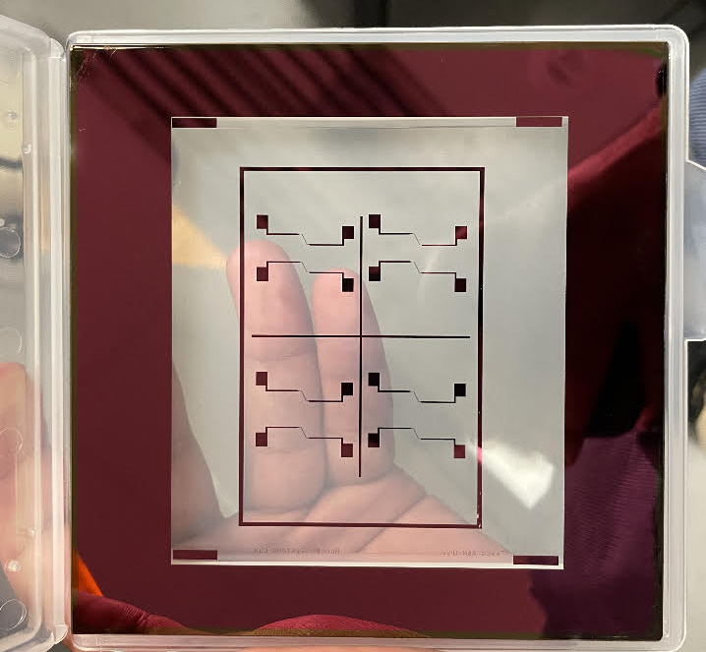
Progress
COMSOL simulations for electric field strength/height between IDE fingers of varying width and distance (see following slides)
Cleanroom training – preparing for IDE fabrication, for our own device
Applied positive/negative resists to gold plate/silicon wafer
Used spin coater to reduce thickness of resist layer
Photolithography using EVG 610 on gold plate using IDE mask
Cleaned off remaining resist, checked IDE pattern under microscope
Application of positive resist to gold plate in spin coater
IDE mask

Slide 3
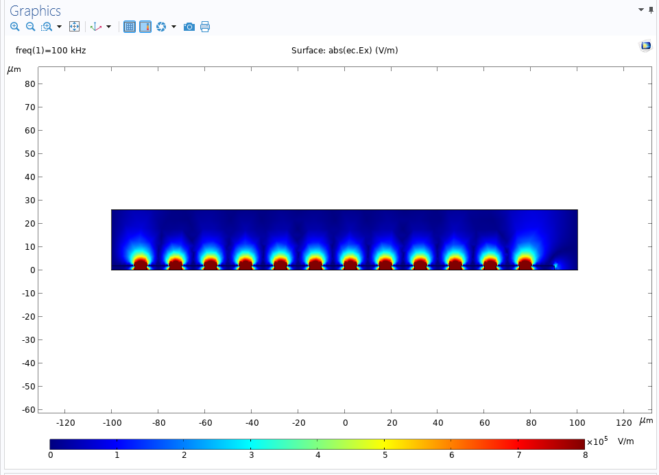
Electric field simulation
Finger width: 5um
Finger distance: 5um

Slide 4
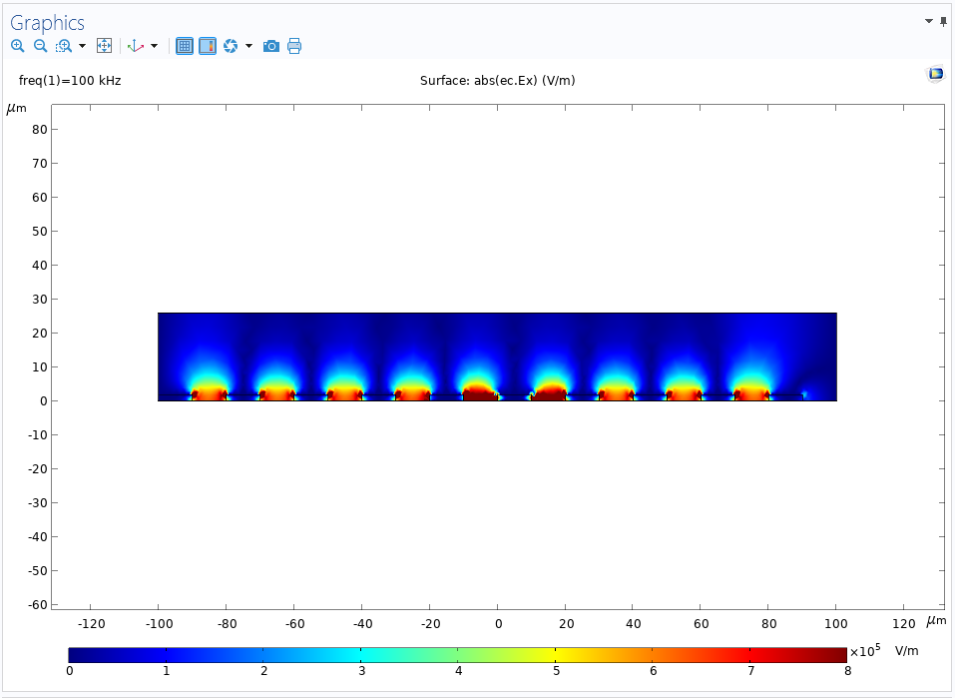
Electric field simulation
Finger width: 10um
Finger distance: 10um

Slide 5
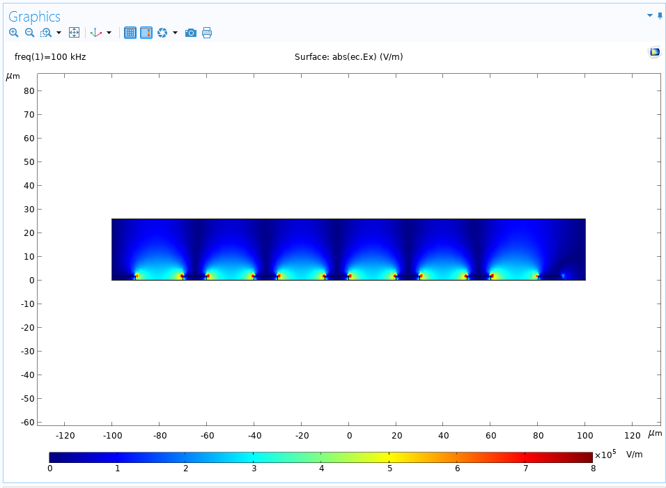
Electric field simulation
Finger width: 20um
Finger distance: 20um

Slide 6
Goals for next week
Continue cleanroom training and IDE fabrication
Wet etching
Metal deposition

Slide 7
Thank you for your time!

